Slide 1
Student — User Flow
Samagama Portal · Student role
Student logs in
Dashboard / home
chooses action ▾
Browse FAQ
Community Q&A
Ask a question
AI chatbot
View answers
Post / answer
Similarity check
Get response
match found?
yes
no
Show suggestion
Submit question
Like / dislike chatbot response
accept/skip
View leaderboard & SP points
Awaits moderation

Slide 2
Moderator — User Flow
Samagama Portal · Moderator role
Moderator logs in
Moderator dashboard
chooses task ▾
FAQ management
Community Q&A queue
review question ▾
action on FAQ ▾
approve
reject
Edit answer
Handle flagged
View stats
Publish to feed
Reject & notify
Student notified
FAQ DB updated

Slide 3
Admin — User Flow
Samagama Portal · Admin role
Admin logs in
Admin dashboard
chooses module ▾
User management
Analytics dashboard
Full FAQ control
System config
Add / remove users
Assign T-Mod role
View analytics
Export report
Override mod actions
Approve / revert
Set thresholds
View history logs
Changes applied — portal updated

Slide 4
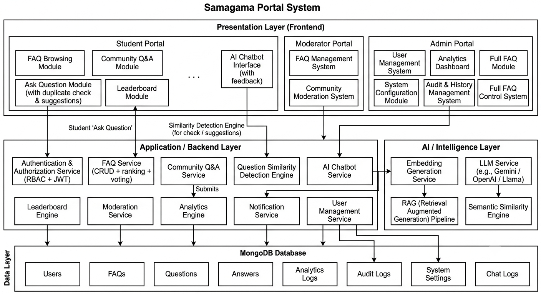

Slide 5
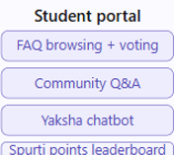
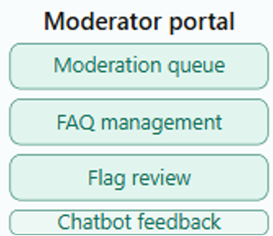
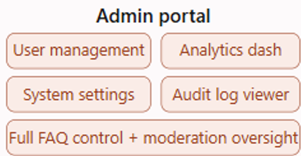
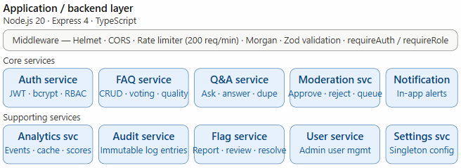

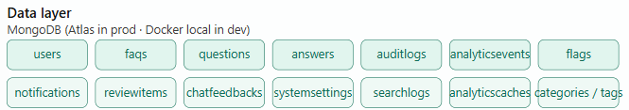
Presentation Layer
React 18. TypeScript. Vite
Chatbot svc . RAG pipeline
Chatbot svc . RAG pipeline

